Slide 1

GCN-Based Recommender System and Sentiment Analysis for Video Games on Amazon
Final Presentation for SDSC 4016 Course Project

Slide 2

Outline
Contents
01.
Method
NGCF
LightGCN
02.
Experiments
Data Overview
Experiment Setting I
Experiment Setting II
03.
Results & Discussion
Experiment results
Sentiment Analysis
04.
Conclusion & Future works

Slide 3
GCN-Based Models
Method | Experiments | Results & Discussion | Conclusion & Future works

Slide 4
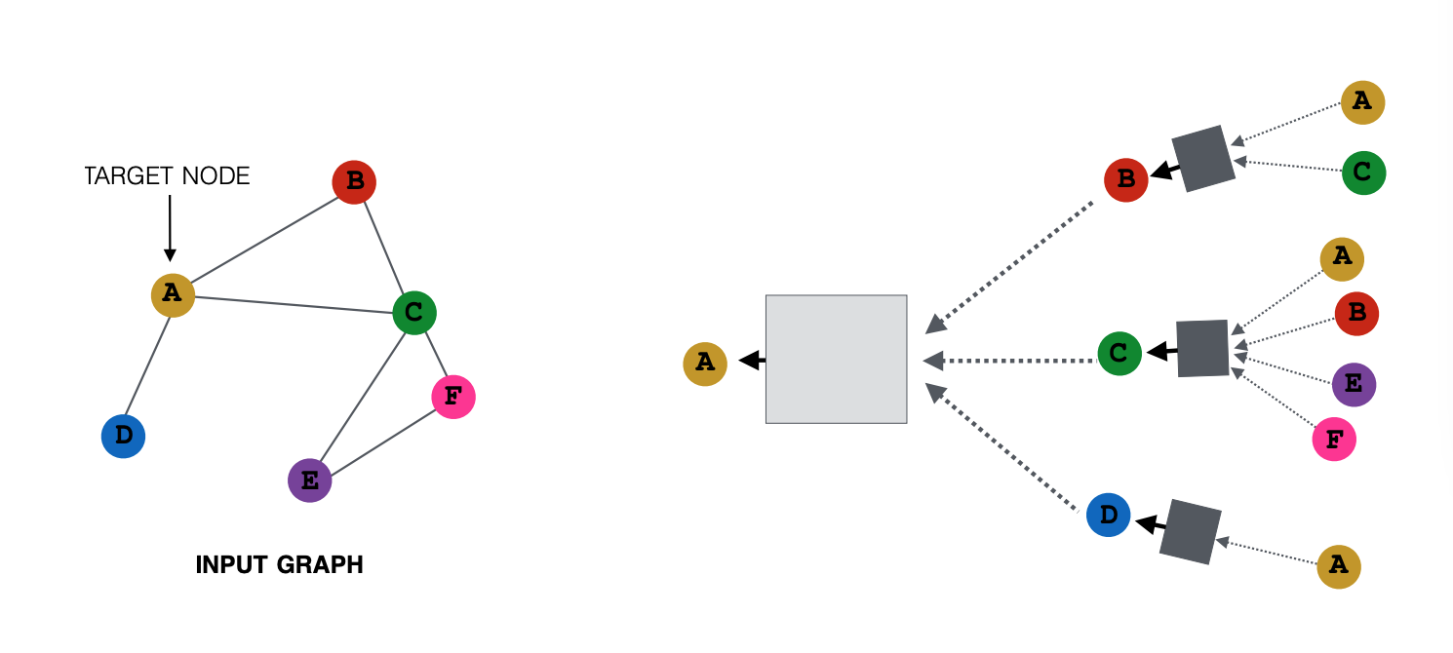
Motivation
Graph Neural Network
GCN in RS
encoding the relationship between nodes and learning patterns in the graph structure
Data in Rec.sys has graph structure: User-item Bipartite Graph representation
Method | Experiments | Results & Discussion | Conclusion & Future works

Slide 5
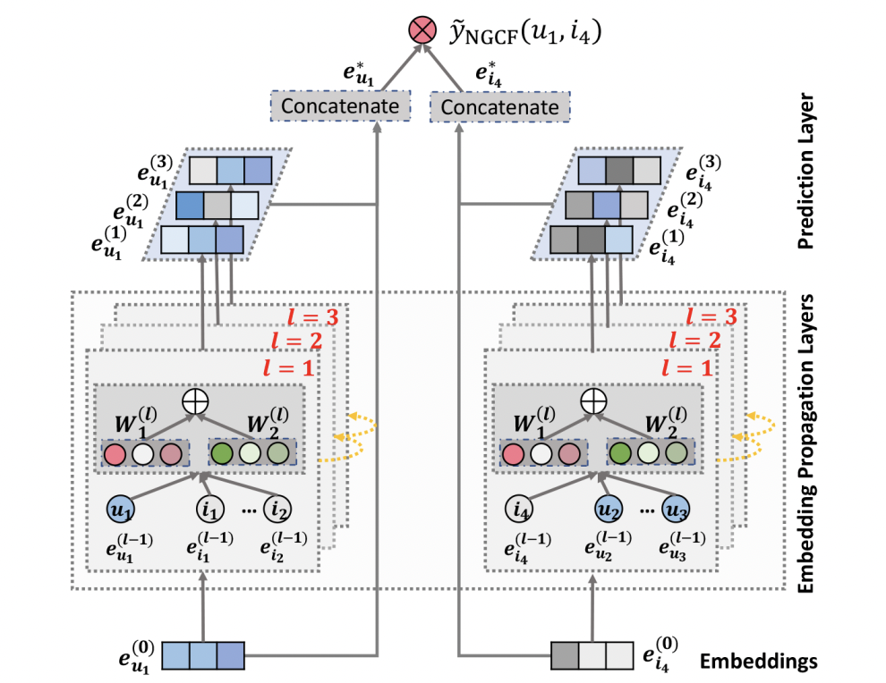
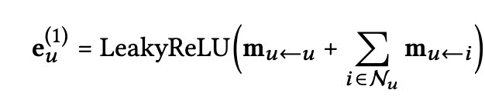
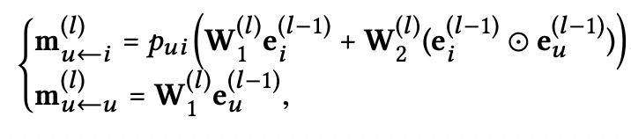
Model Training
NGCF
Integrate the user-item interactions — more specifically the bipartite graph structure — into the embedding process
Exploits the user-item graph structure by propagating embeddings on it.
Method | Experiments | Results & Discussion | Conclusion & Future works

Slide 6
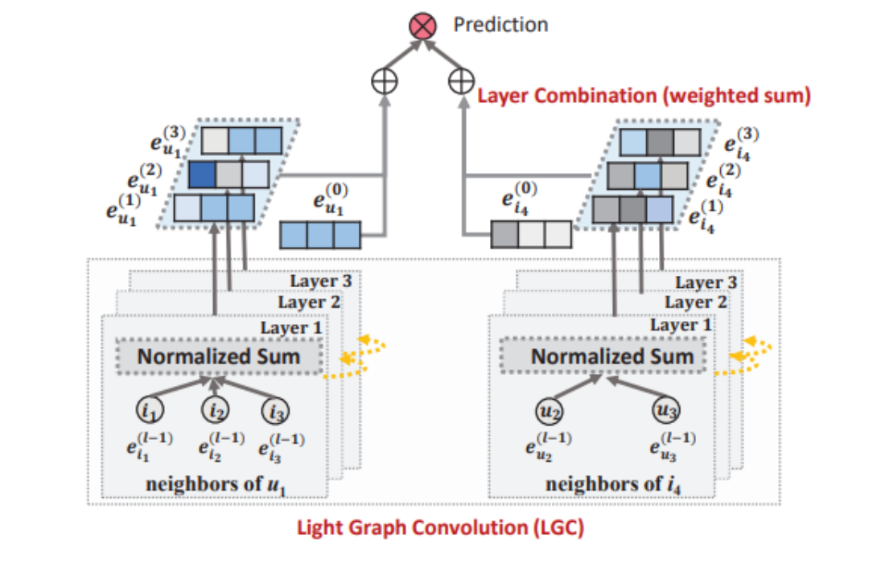
Model Training
LightGCN
A model including only the most essential component in GCN -- neighborhood aggregation, which is for collaborative filtering.
Learns user and item embeddings by linearly propagating them on the user-item interaction graph.
Weighted sum of the embeddings learned at all layers as the final embedding.
Exhibits substantial improvements over Neural Graph Collaborative Filtering (NGCF) under exactly the same experimental setting.
Method | Experiments | Results & Discussion | Conclusion & Future works

Slide 7
Experiment
Method | Experiments | Results & Discussion | Conclusion & Future works

Slide 8

Experiments
Data Overview
Overview of Metadata
Include info for total 84819 items
asin - ID of the product, e.g. B00H512H234
title - name of the product
feature - bullet-point format features of the product
description - description of the product
also_buy - items that are also purchased
also_view - items that are also viewed
Experiment Setting I
Experiment Setting II
Method | Experiments | Results & Discussion | Conclusion & Future works

Slide 9
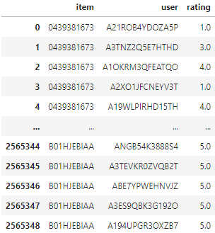
Experiments
Data Overview
Overview of Rating Data
The total has 349 records, 71982 unique items and 1540618 unique users.
Ratings vary from 1.0 to 5.0, there are 1899779 records whose ratings are larger than 3.0
Experiment Setting I
Experiment Setting II
Method | Experiments | Results & Discussion | Conclusion & Future works

Slide 10
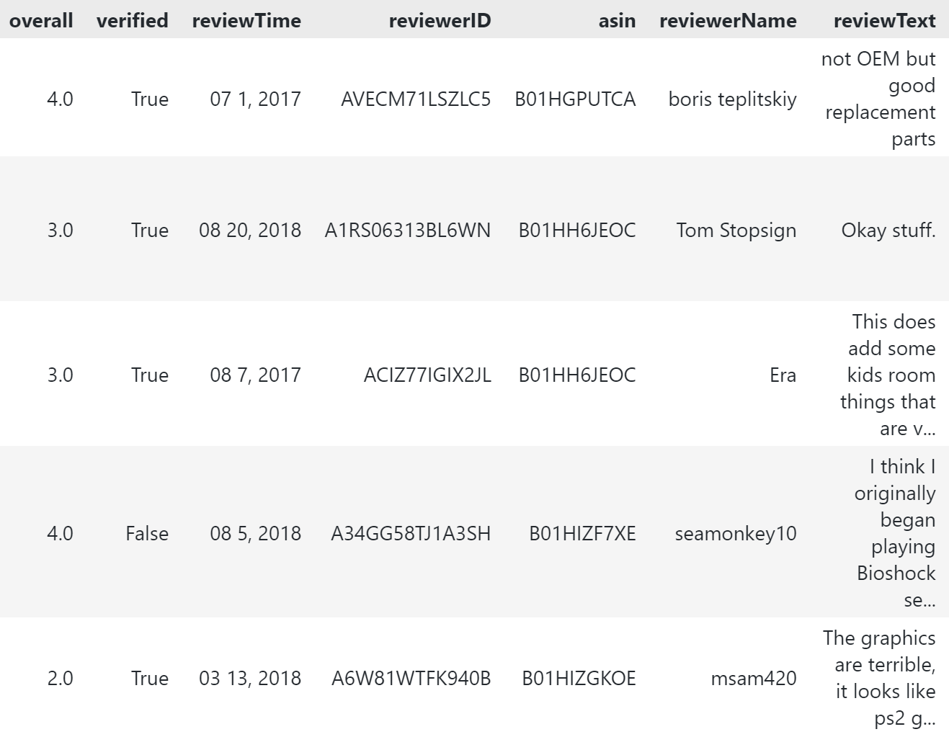
Experiments
Data Overview
Overview of Reviews Data
Dataset: 497577 reviews
Use ratings (overall) to label positive(>3) and negative(<=3) review.
Split dataset into train and test sets for training sentiment analysis model
Experiment Setting I
Experiment Setting II
Method | Experiments | Results & Discussion | Conclusion & Future works

Slide 11

Experiments
Data Overview
Experiment Setting I
Construct Recommendation system using NGCF/LightGCN on Video games reviews dataset
Dataset
Metric
Select ratings >= 3 to gather implicit feedback from users of suggesting video games
Split dataset to train and test, filter out cold-start users and items in the test set
Recall@20, Precision@20, NDCG@20
Hyper-parameter:
Embeddings dimension: 40 Total number of layers: 4 (Will be experimented)
Baseline
Loss function:
Bayesian personalized ranking
Collaborative filtering Methods:
User CF
SVD
Experiment Setting II
Method | Experiments | Results & Discussion | Conclusion & Future works

Slide 12
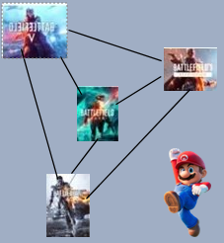
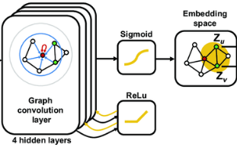
Experiments
Data Overview
Experiment Setting I
Experiment Setting II
Utilize similar product network from metadata of the dataset
to enhance recommendation performance
Methodology
Obtain trained embeddings from link prediction task using GCN networks
Use the pre-trained embeddings to build recommendation system
Item-item interactions
Method | Experiments | Results & Discussion | Conclusion & Future works

Slide 13
Experiments
Data Overview
Experiment Setting I
Rank
Experiment Setting II
Compare the performance of NGCF/LightGCN with embeddings pre-trained from GCN and without pre-train embeddings
Datasets
Metric
Treat items in "also_buy" and "also_view" from the metadata dataset as similar products for the item. Construct network graph between each item and its similar items.
NDCG@20
Hyper-parameter:
Embeddings dimension: 40
Total number of layers: 4
Model Architecture
Loss function:
Bayesian personalized ranking
4 GCN layers with ReLu as the activation function
Sigmoid function
Method | Experiments | Results & Discussion | Conclusion & Future works

Slide 14
Results & Discussion
Method | Experiments | Results & Discussion | Conclusion & Future works

Slide 15
Results - Experiment I.
Model Comp.
 | Amazon video games
 | recall@20 | precision@20 | ndcg@20
User CF | 0.0442 | 0.0014 | 0.0212
SVD | 0.0314 | 0.0022 | 0.0423
NGCF | 0.0825 | 0.0108 | 0.0866
LightGCN | 0.0997 | 0.0203 | 0.1387
Sentiment Analysis
Word Cloud
Method | Experiments | Results & Discussion | Conclusion & Future works

Slide 16
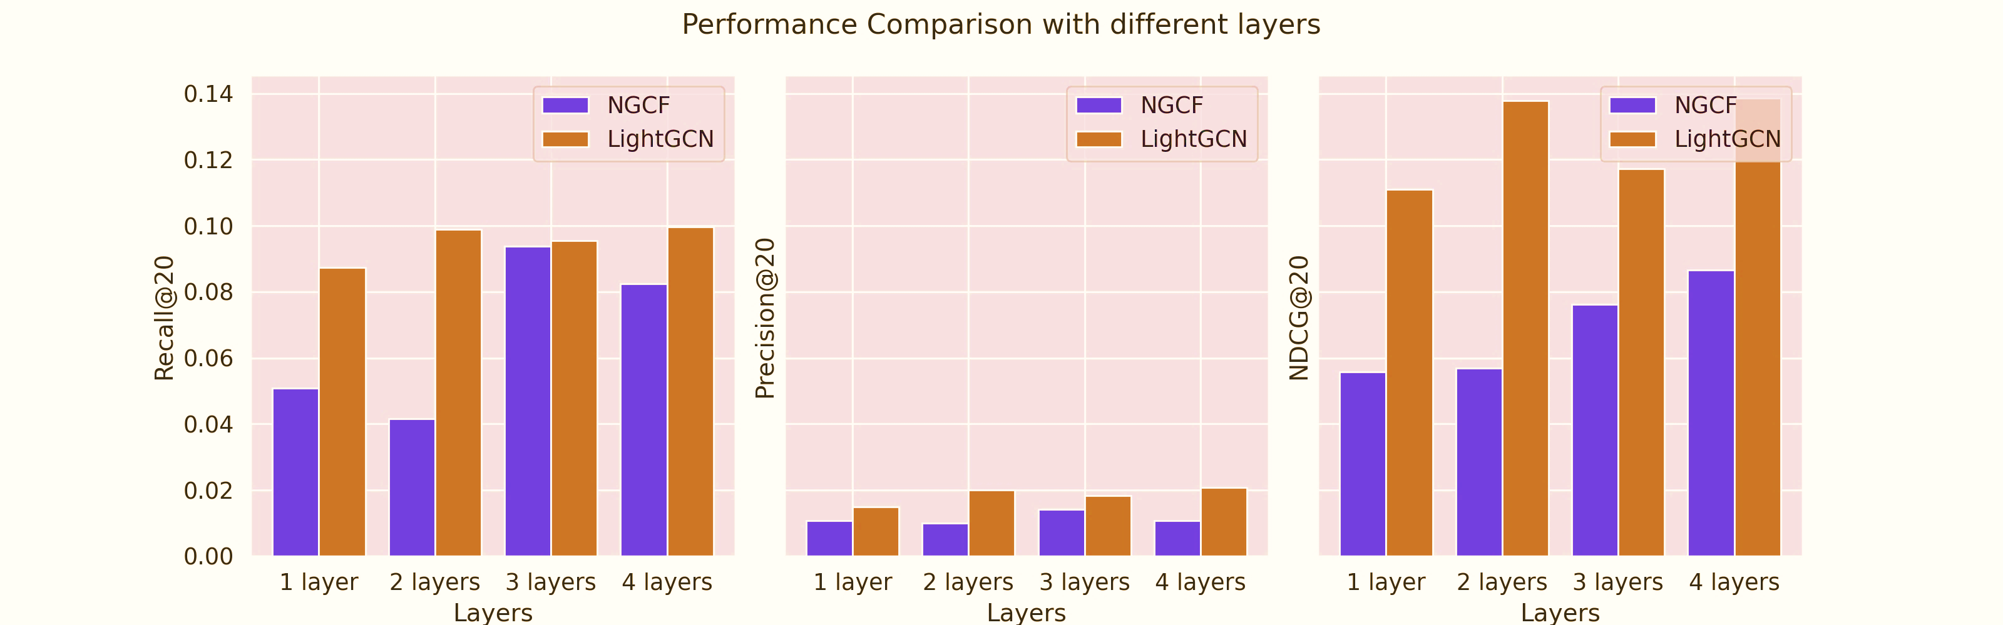
Results - Experiment I.
Model Comp.
Sentiment Analysis
Word Cloud
Method | Experiments | Results & Discussion | Conclusion & Future works

Slide 17
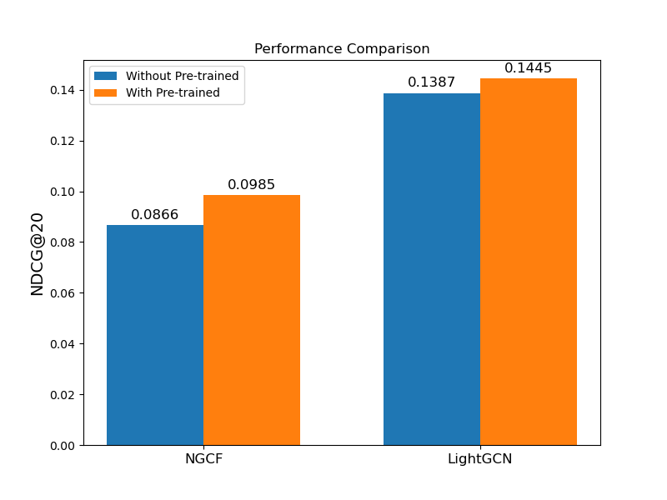
Results - Experiment II.
Model Comp.
Sentiment Analysis
Word Cloud
Method | Experiments | Results & Discussion | Conclusion & Future works

Slide 18
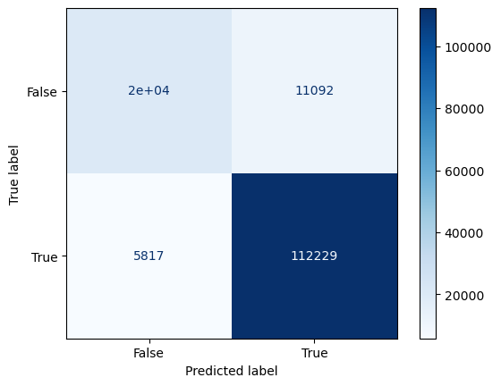
Sentiment Analysis
Model Comp.
Sentiment Analysis
Finetuned the pretrained GPT-2 small model with 12-layer, 768-dimensional embedding vector, 117M parameters
Add a linear layer on the top for sentiment classification
Achieved 89% accuracy in the test set with 130000 samples.
Word Cloud
Method | Experiments | Results & Discussion | Conclusion & Future works

Slide 19


Sentiment Analysis
Model Comp.
Sentiment Analysis
Word Cloud
Method | Experiments | Results & Discussion | Conclusion & Future works

Slide 20
Conclusion & Future works
Method | Experiments | Results & Discussion | Conclusion & Future works

Slide 21
Conclusion
Construct GCN based recommendation system based on Amazon Video game reviews using NGCF and LightGCN
Compare GCN models' performances and experiment models under different parameters
Utilizing side information to pre-train embeddings using GCN network
Finetune the pre-trained GPT-2 small model on the review train set, perform sentiment analysis on the data
Method | Experiments | Results & Discussion | Conclusion & Future works

Slide 22

Future Directions
Cold-Start
Inductive graph learning ---GraphSAGE (AAAI 2020)
Incorporating Knowledge graph ---KGCN (AAAI 2019)
Leverage Attention mechanism
Learning embeddings using attention—GAT (AAAI 2020)
Scalability
Sampling: node level –GraphSAGE (AAAI 2020)
Layer level – FastGCB (AAAI 2020)
Method | Experiments | Results & Discussion | Conclusion & Future works

Slide 23
References
[1] Ni, J., Li, J., & McAuley, J. (2019). Justifying recommendations using distantly-labeled reviews and fine-grained aspects. Proceedings of the 2019 Conference on Empirical Methods in Natural Language Processing and the 9th International Joint Conference on Natural Language Processing (EMNLP-IJCNLP). https://doi.org/10.18653/v1/d19-1018
[2] Deng, K., Huang, J., & Qin, J. (2020). GCN-ICF: Graph convolution networks for item-based recommendation. 2020 IEEE/WIC/ACM International Joint Conference on Web Intelligence and Intelligent Agent Technology (WI-IAT). https://doi.org/10.1109/wiiat50758.2020.00018
[3] He, X., Deng, K., Wang, X., Li, Y., Zhang, Y., & Wang, M. (2020). LightGCN. Proceedings of the 43rd International ACM SIGIR Conference on Research and Development in Information Retrieval. https://doi.org/10.1145/3397271.3401063
[4] Tabinda Kokab, S., Asghar, S., & Naz, S. (2022). Transformer-based deep learning models for the sentiment analysis of social media data. Array, 14, 100157. https://doi.org/10.1016/j.array.2022.100157

Slide 24
 | AIC | BIC
GJR-GARCH | 3652.76 | 3678.45
GARCH | 3674.11 | 3704.93

Slide 25

Thanks!

